Slide 1
IS609 Final
Max Wagner

Slide 2
Project One
Consider an endurance test that measures only aerobic fitness. This test could be a swimming test, running test, or bike test. Assume that we want all competitors to do an equal amount of work. Build a mathematical model that relates work done by the competitor to some measureable characteristic, such as height or weight. Next consider a refinement using kinetic energy in your model. Collect some data for one these aerobic tests and determine the reasonableness of these models.

Slide 3


Approach

Slide 4
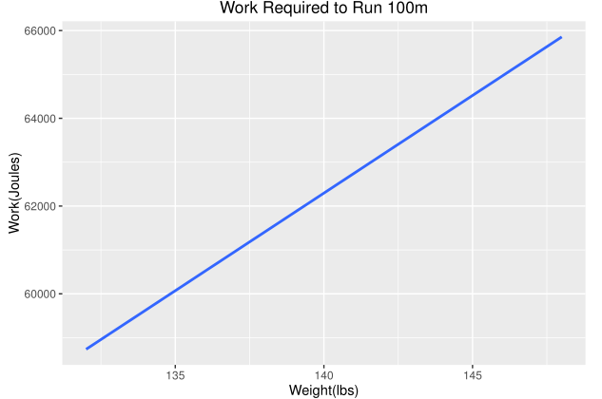

Slide 5

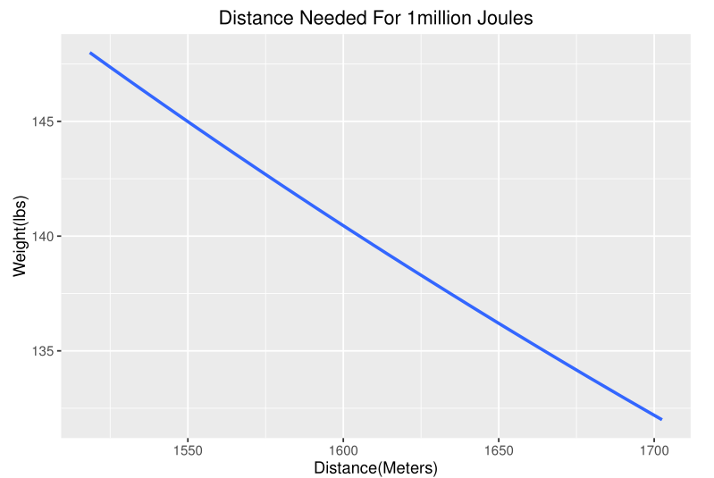
Notes:
A 200lb runner would only need to go 1123m with this model

Slide 6

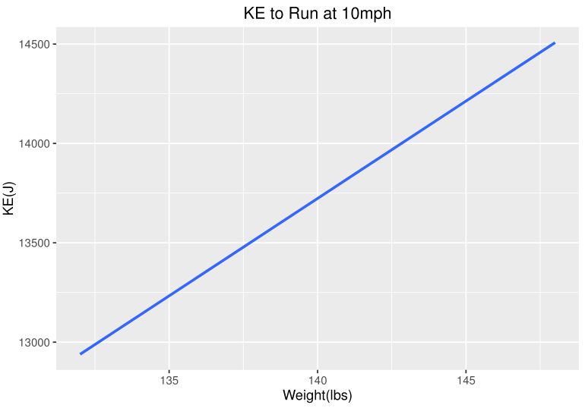
Kinetic Energy Model
Notes:
In this case adjust for velocity, not distance, while keeping time the same

Slide 7
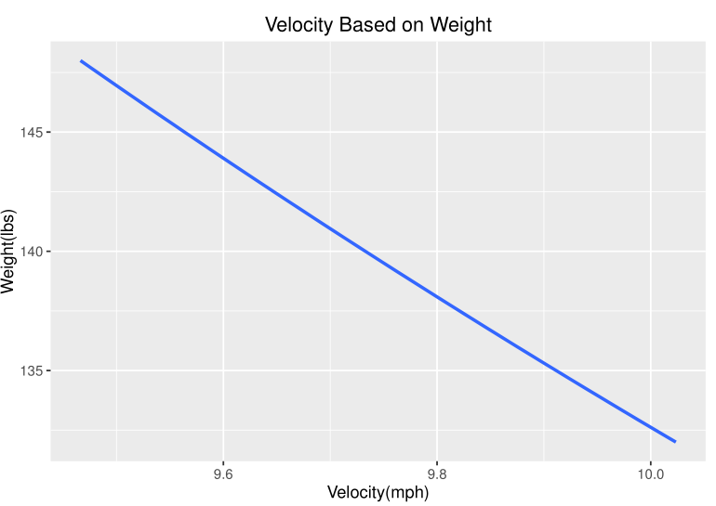
Kinetic Energy at 13000J

Slide 8
Project Two
Should US citizens build their own retirement through 401Ks or use the current Social Security program? Build models to be able to compare these systems and provide decisions that can help someone to plan a better retirement.

Slide 9
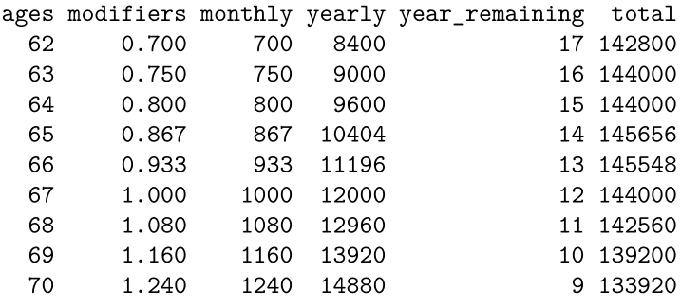
Income and Modifiers

Slide 10
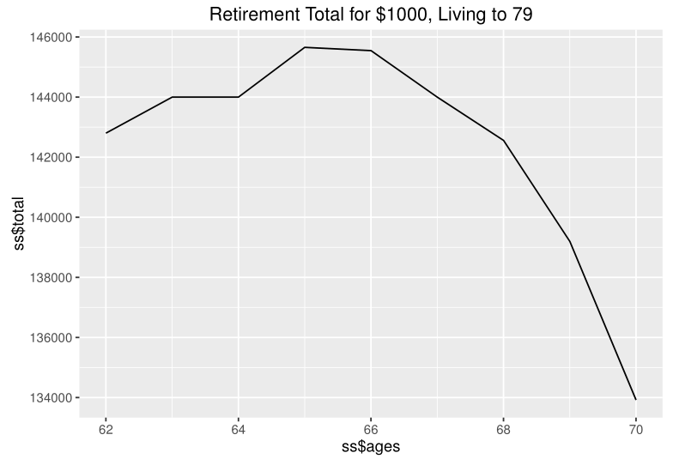

Slide 11
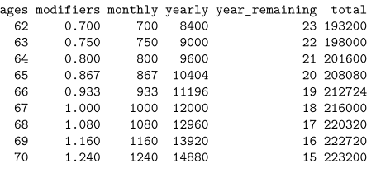

Slide 12
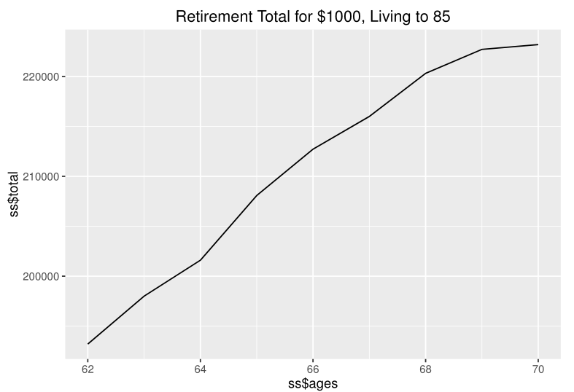

Slide 13
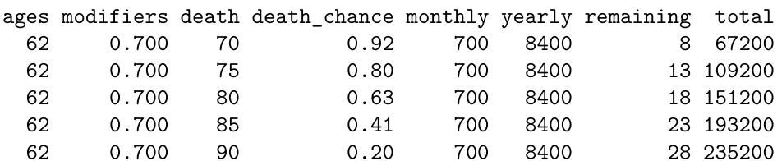

Slide 14
